Slide 1
Online programming contest judge
Code Shamlao
Code
Samlao
MOCK UI

Slide 2
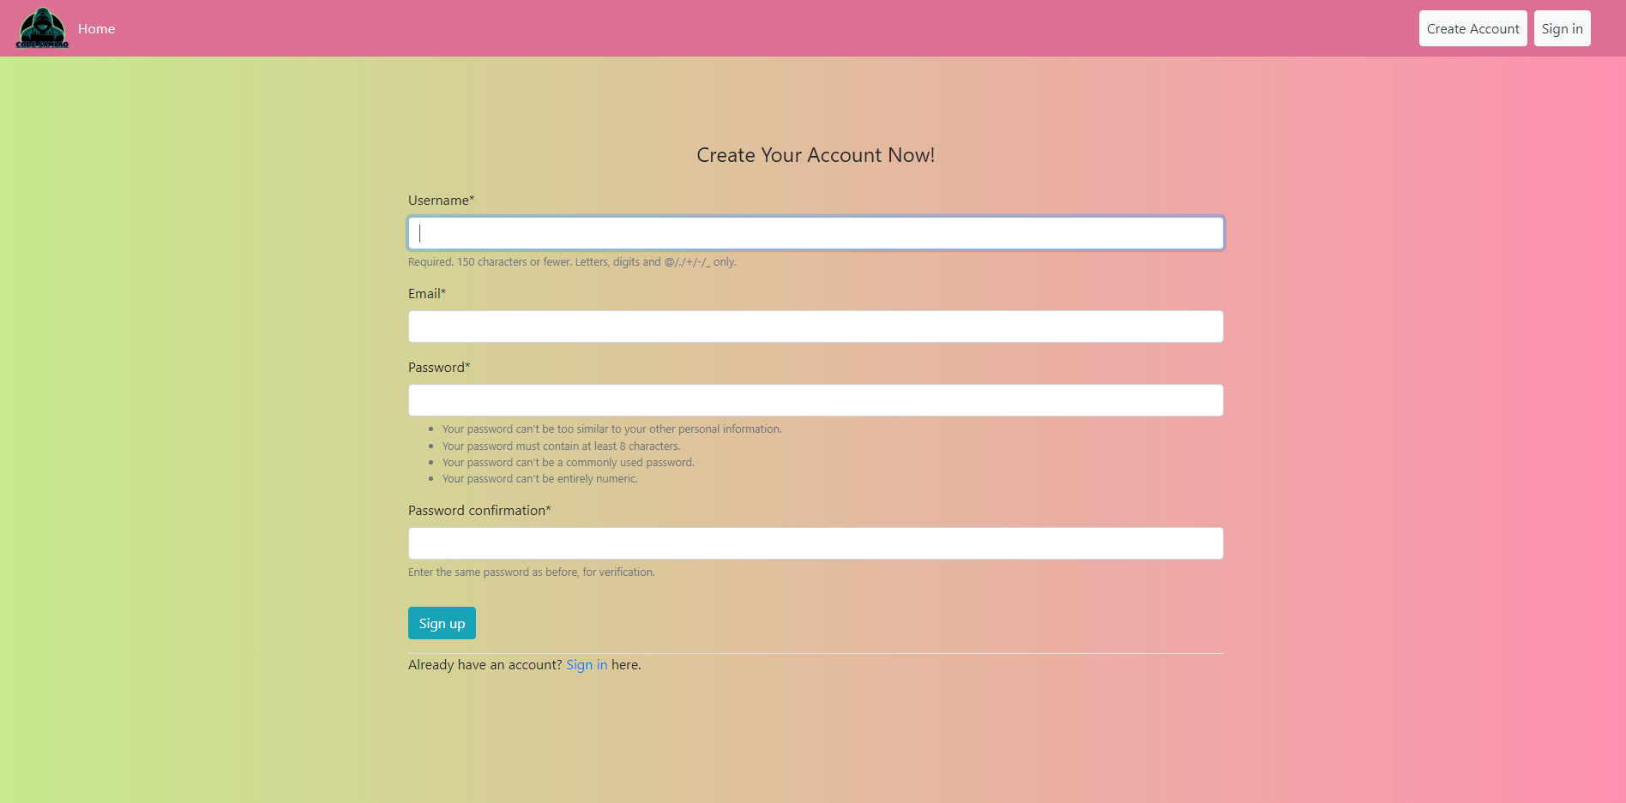
Sign up

Slide 3
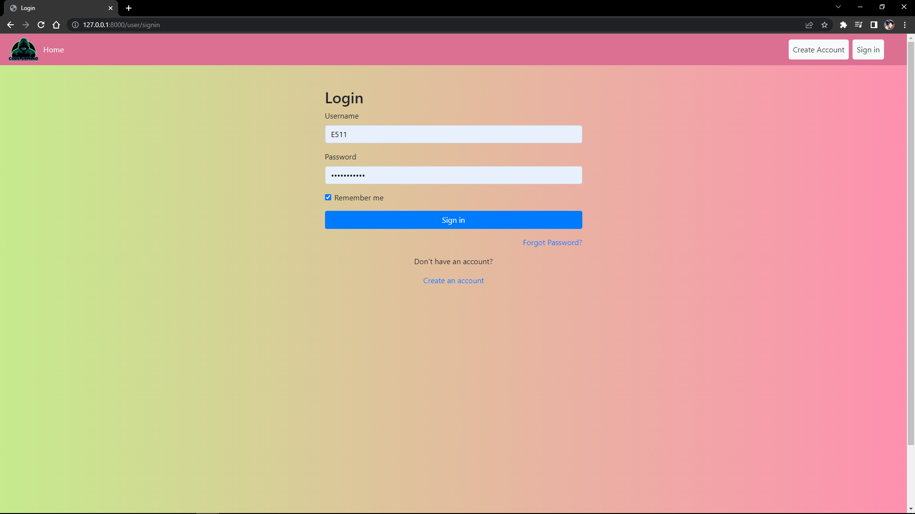
Log in

Slide 4

Home page

Slide 5
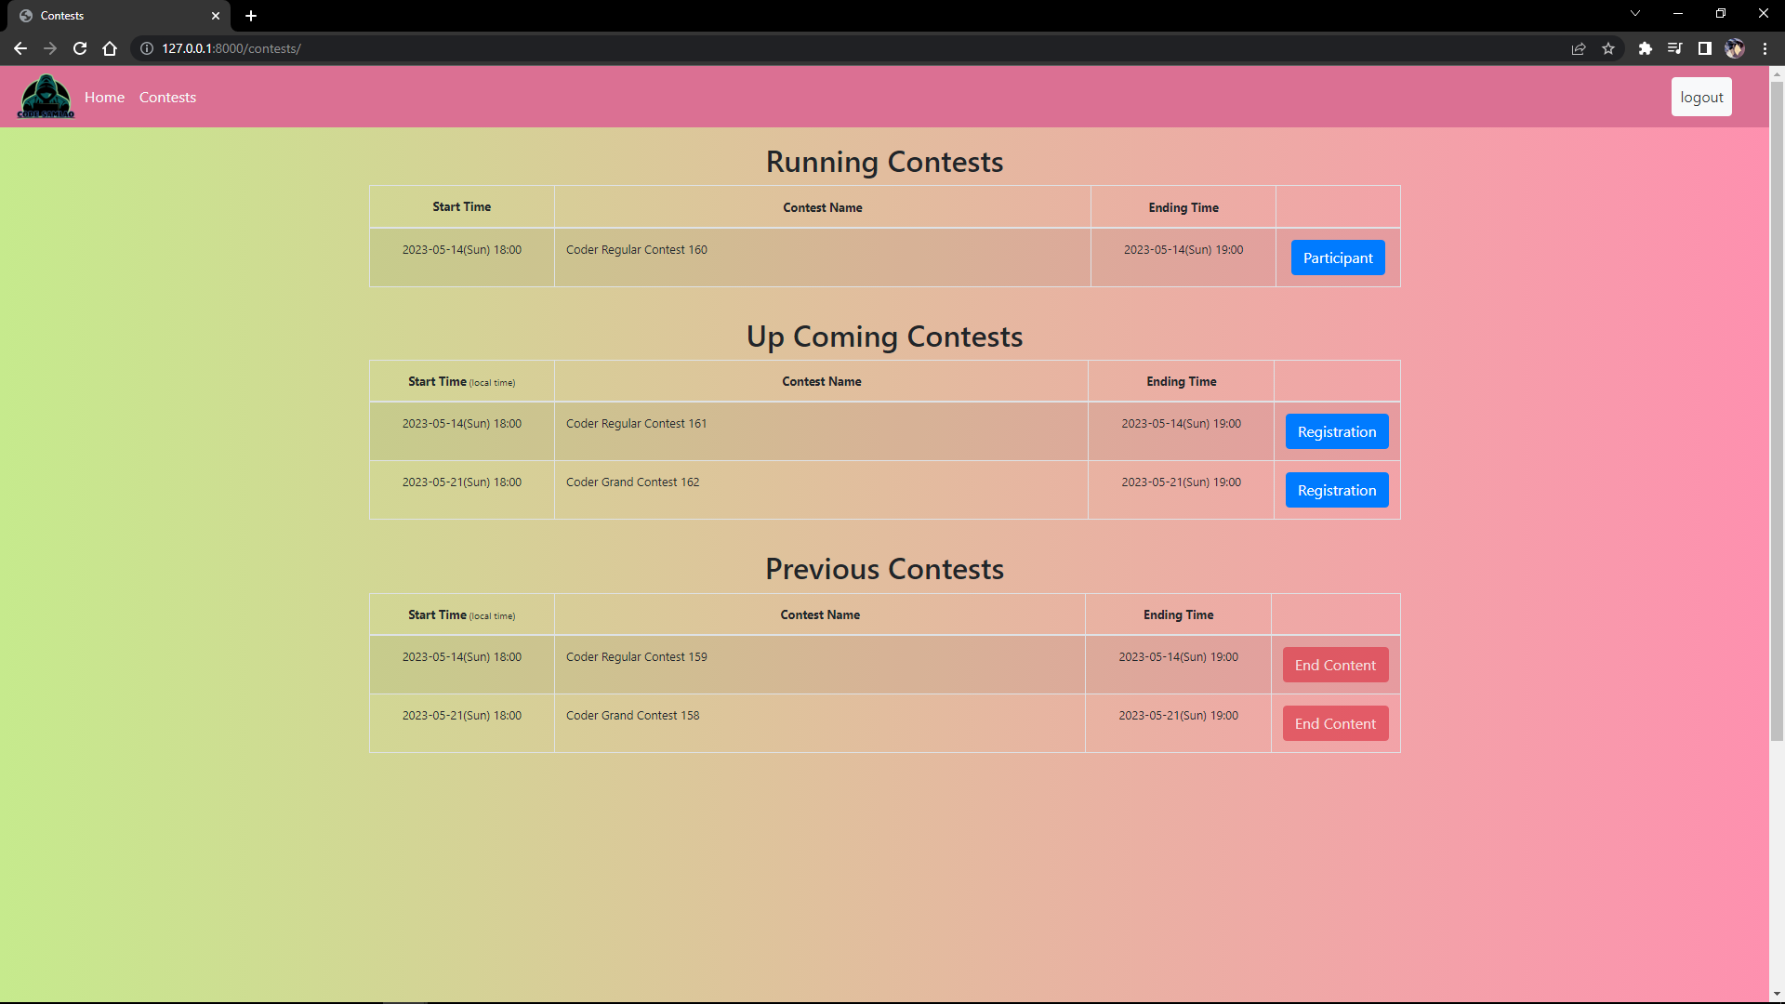
Contest page

Slide 6
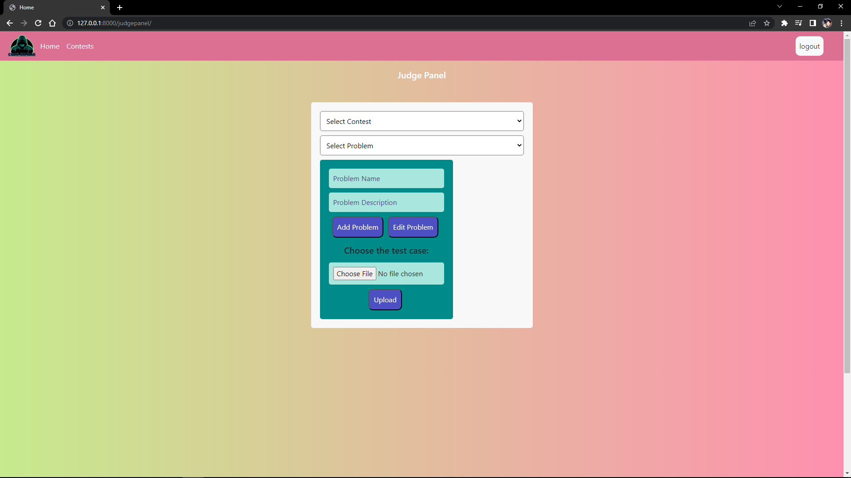
Judge panel

Slide 7
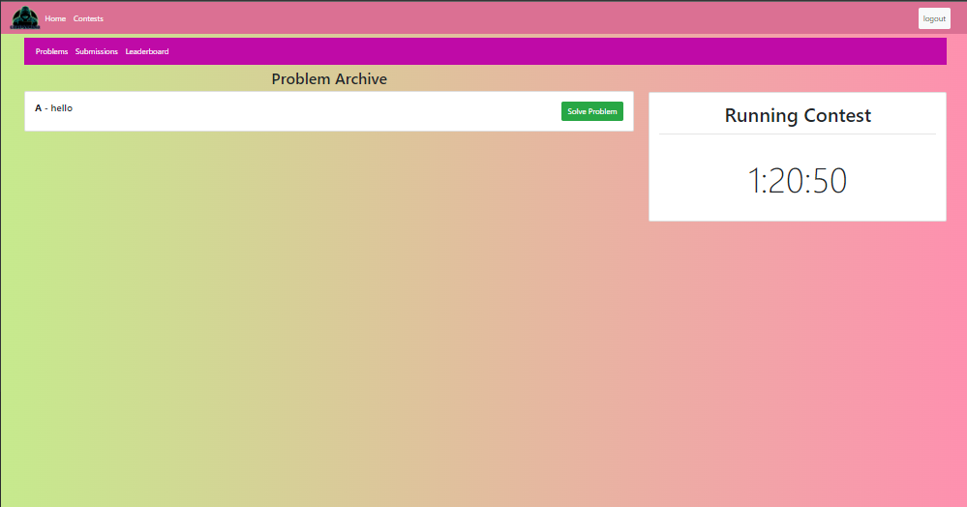
Running contests

Slide 8
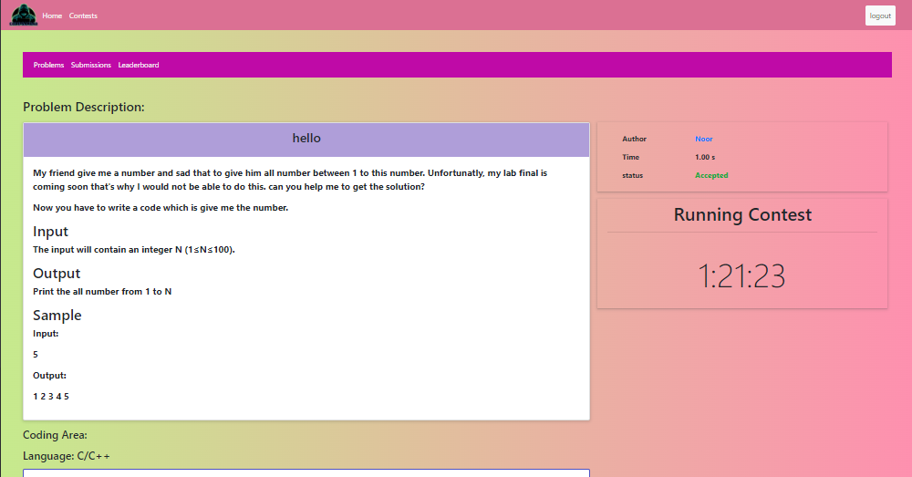
Problem solving and code submission

Slide 9
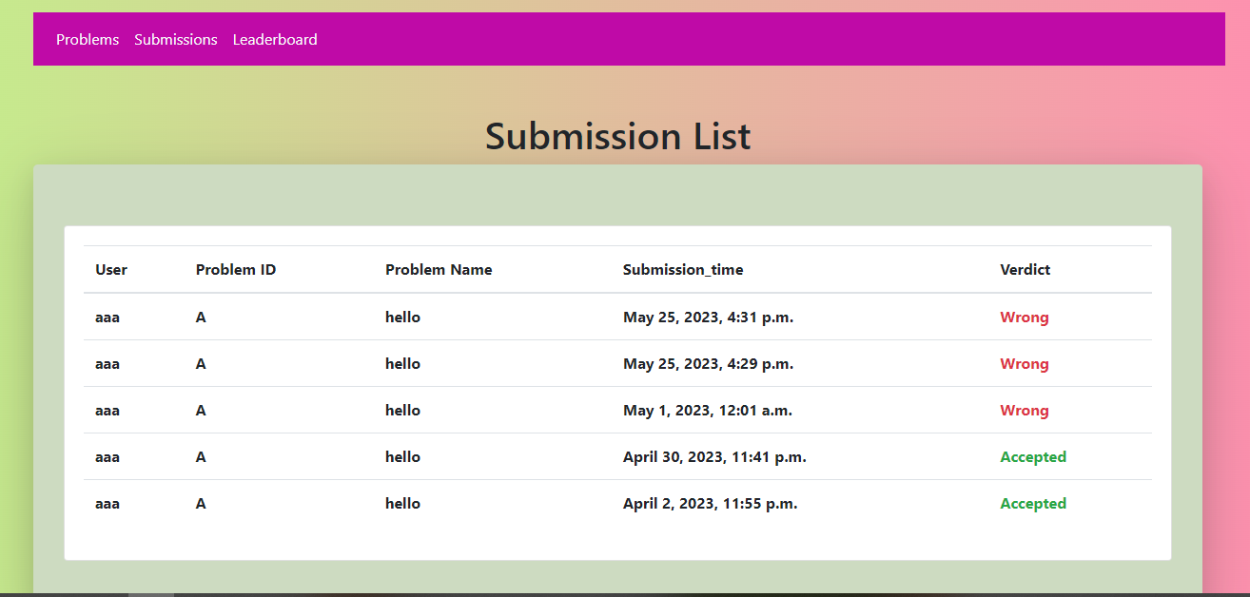
Submission list

Slide 10
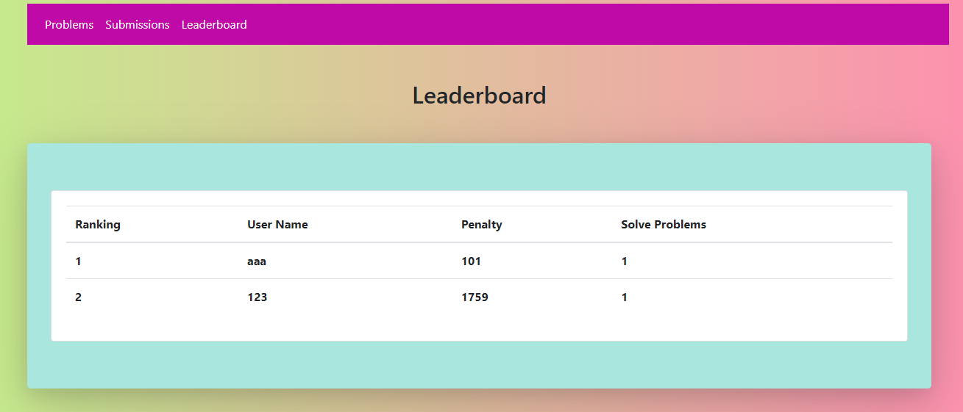
Leaderboards

Slide 11
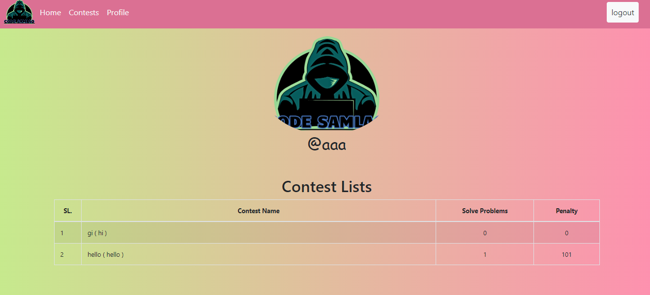
History

Slide 12
Thanks for watching
20101106
Mohammad Enan Al harun
Sheikh nafez sadnan
Md. Asadujjaman noor
20101095
20101101

